Slide 1


CMPE 202
Software Systems Engineering
Final Presentation & Demo
Avengers – The Game
Notes:
Hello everyone/ Good Afternoon everyone,
Welcome to Project Final Presentation and Demo 1 !

Slide 2

MEET THE TEAM
>> Huy Vo
>> Mangesh Tak
>> Prateek Sharma
>> Kalikalyan Dash
>> Sricheta Ruj
Notes:
As you all are aware, The title of the project is Distributed Online Banking System,
And in today’s progress report we will be covering the following points.
> Meet the team
> Project Design Overview
> Features Planned
Early Results
‘> Current Impediments
> Project Schedule(Tentative)
> Individual Team Member’s Role

Slide 3
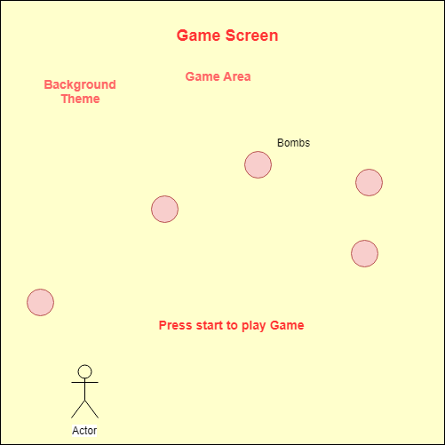
UI WireFrames

Slide 4
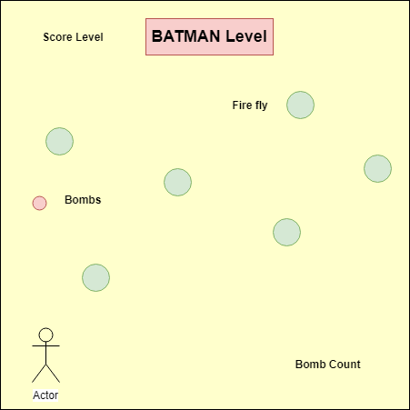
UI WireFrames

Slide 5
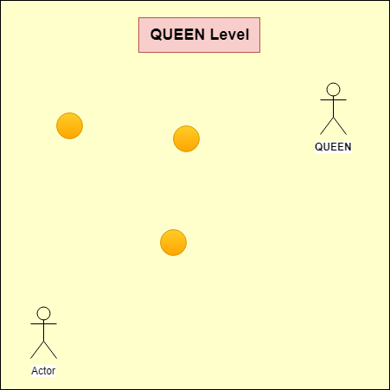
UI WireFrames

Slide 6
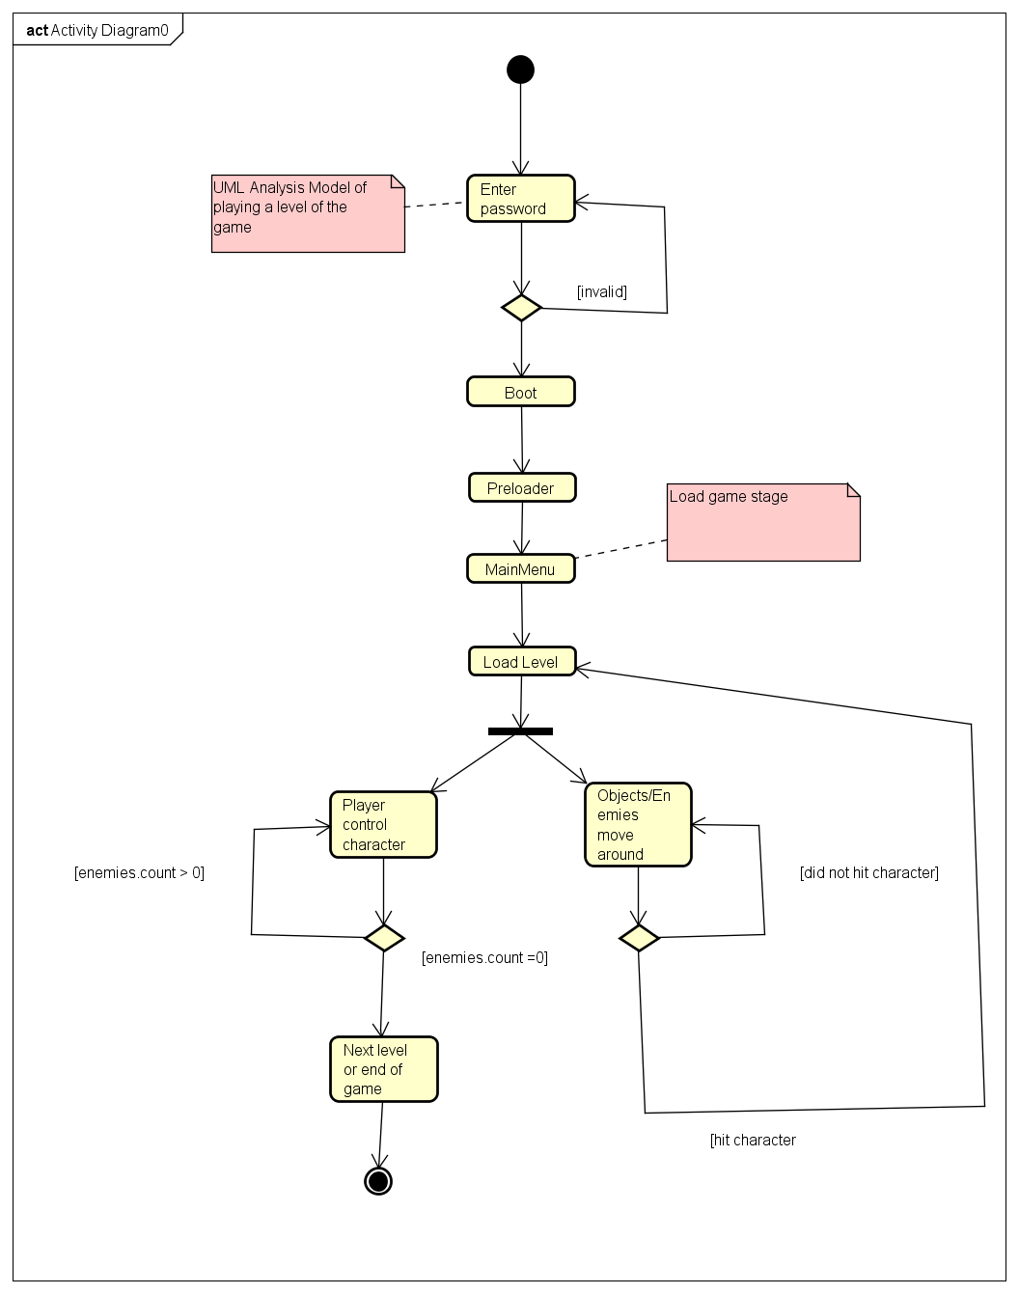
Activity
Diagram

Slide 7
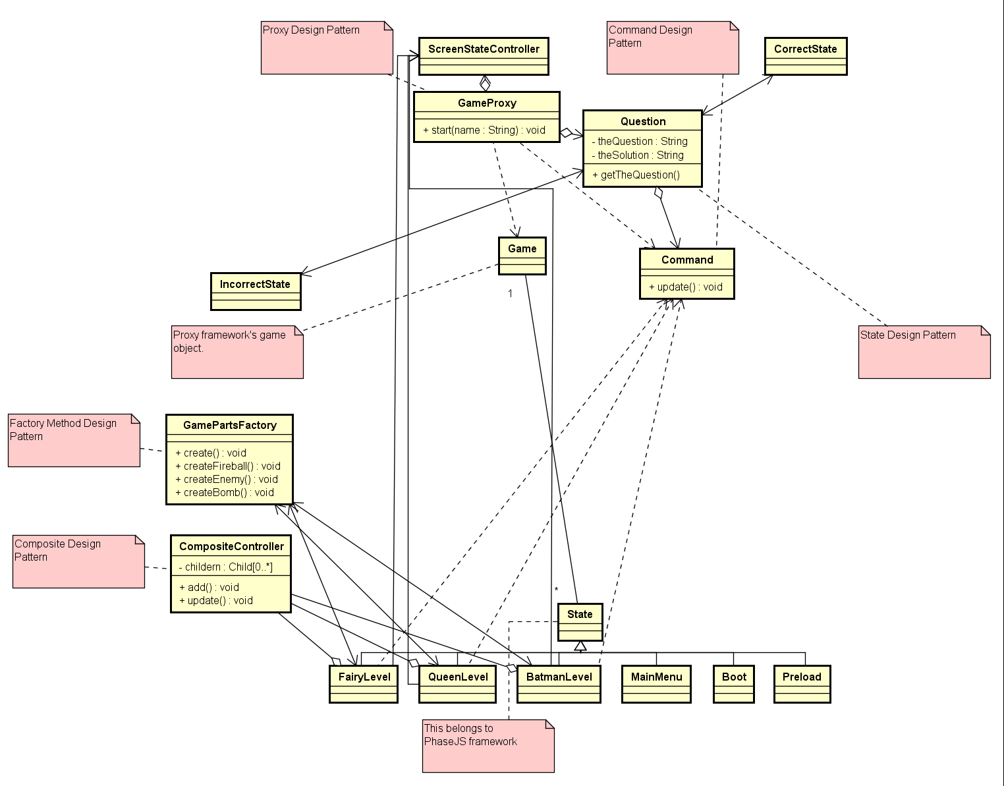
Class
Diagram

Slide 8
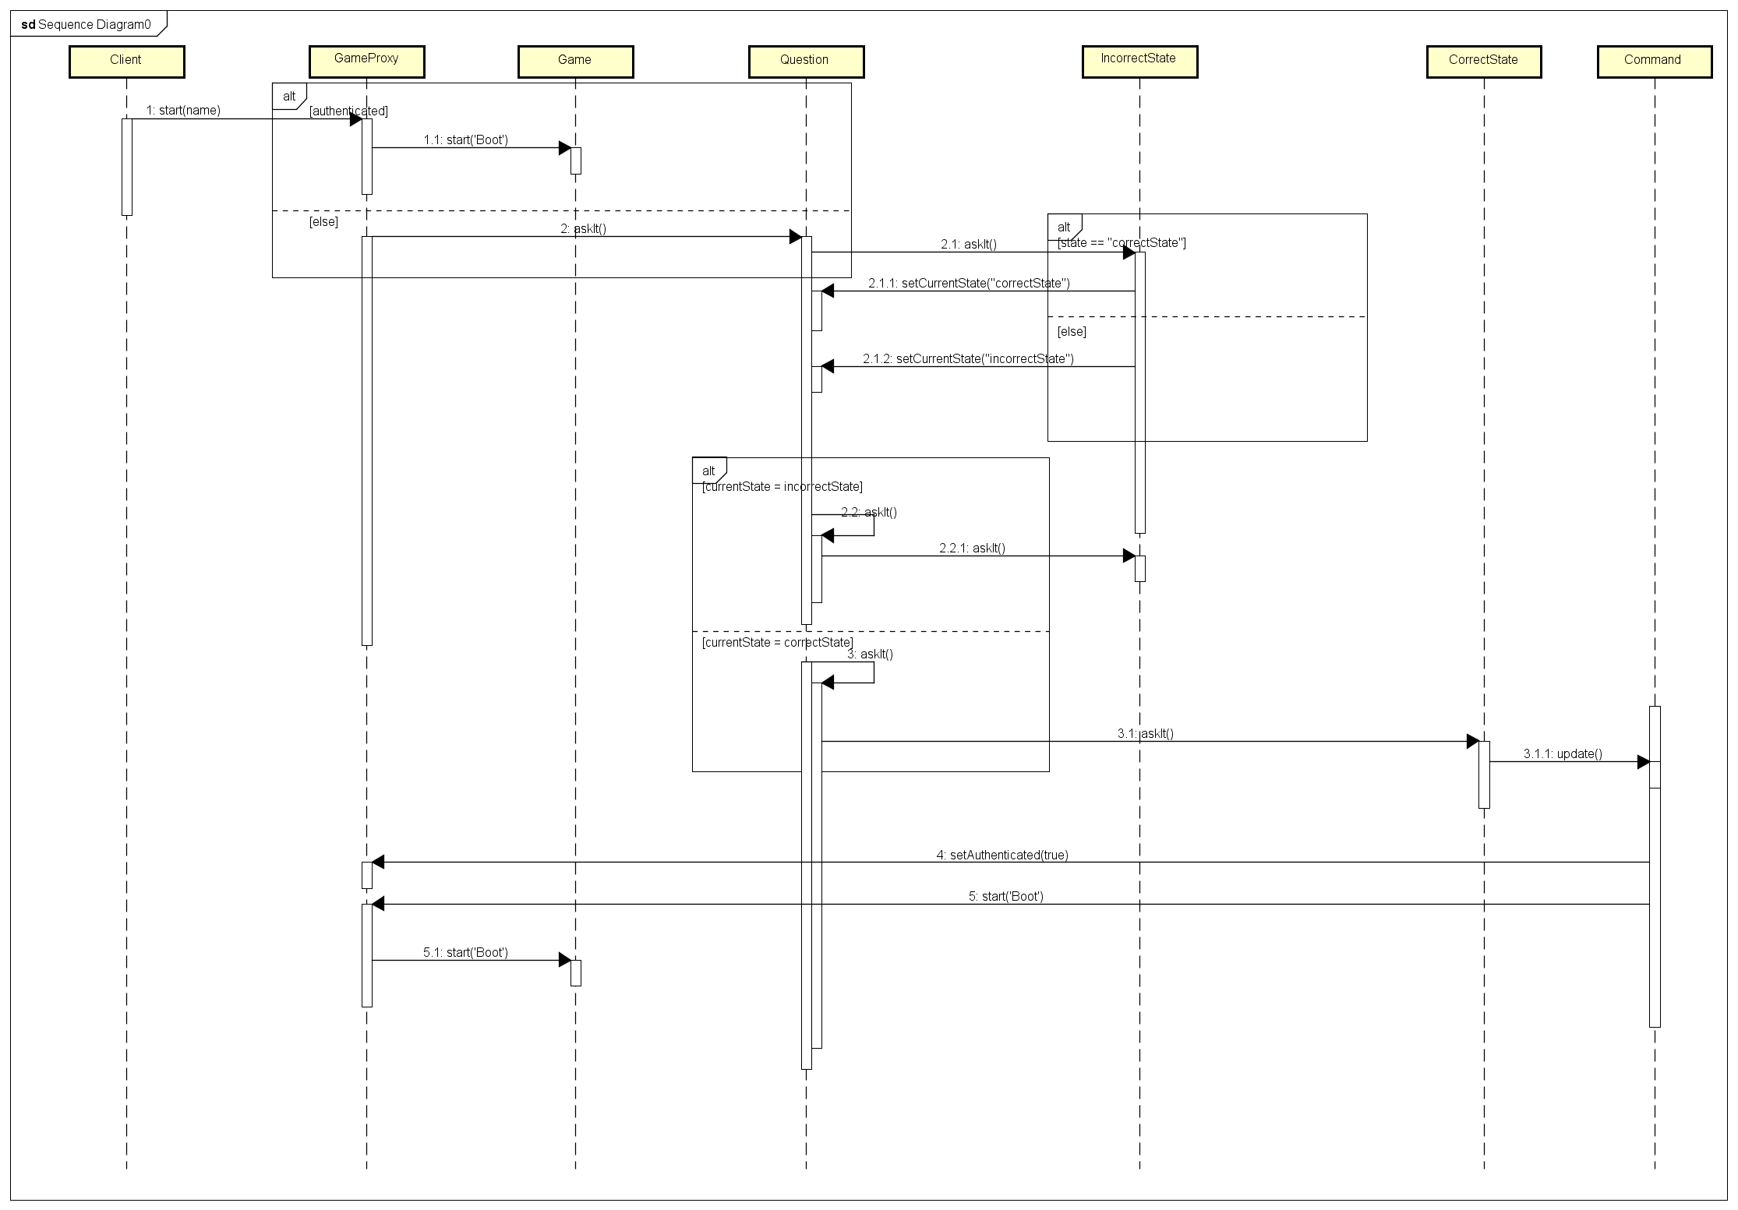
Sequence Diagram

Slide 9
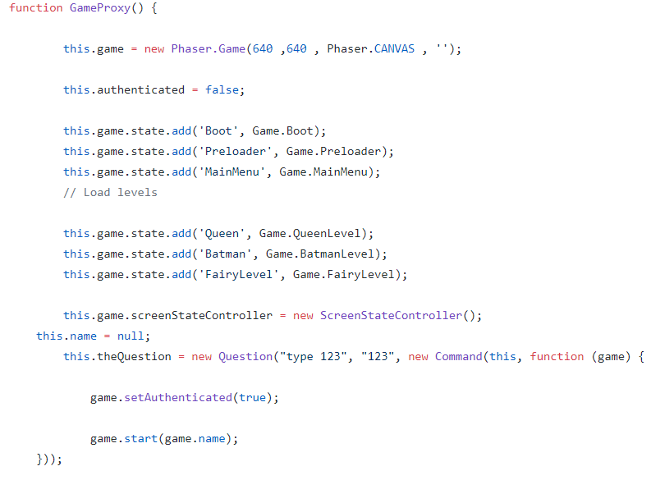
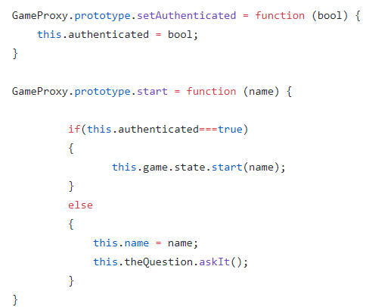
Design Patterns Implemented
>> Proxy – Initial Authentication

Slide 10
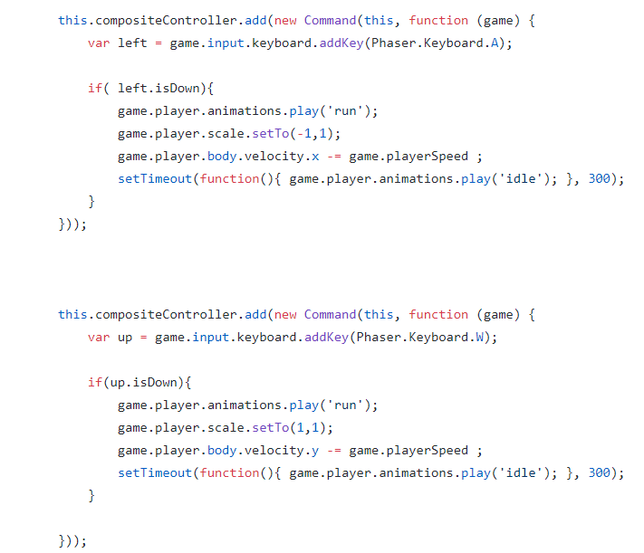
Design Patterns Implemented
>> Command – Firing, Add new bombs, Update score, bombs left

Slide 11
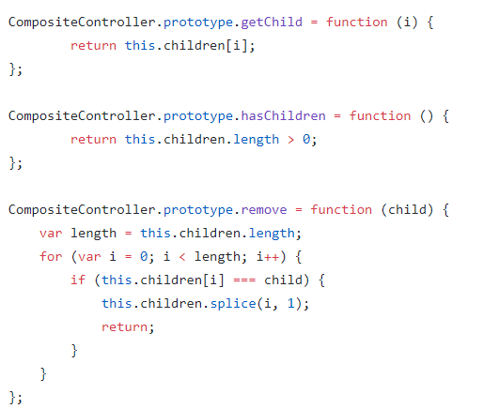
Design Patterns Implemented
>> Composite – Integrate all the components in each level

Slide 12
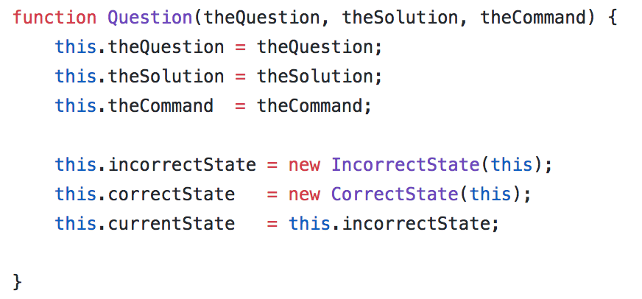
Design Patterns Implemented
>> State – Maintaining the state if user answer question correctly

Slide 13
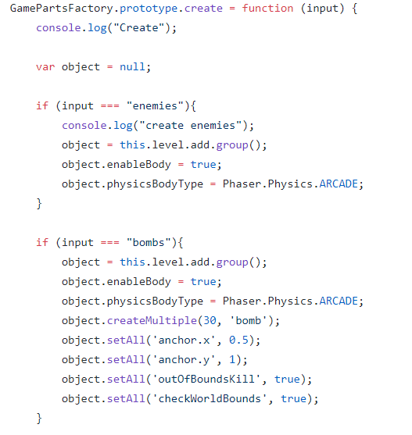
Design Patterns Implemented
>> Factory – Construct enemies, obstructions, bombs and bullets

Slide 14
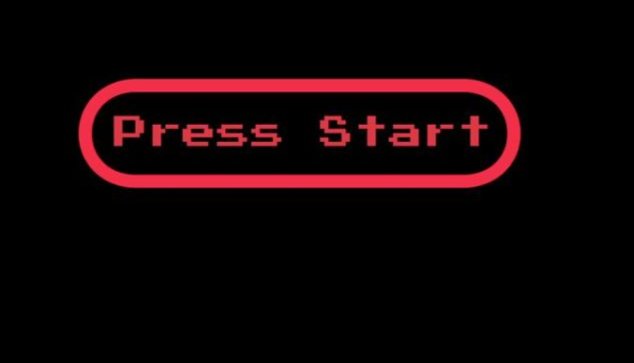
Game Snapshots

Slide 15
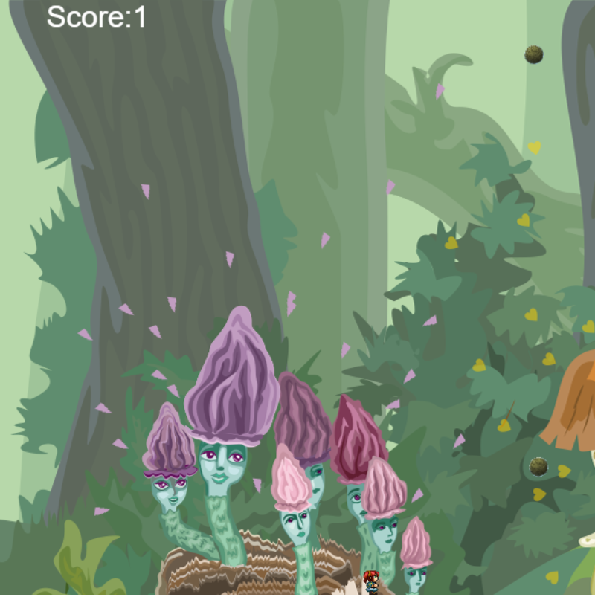
Game Snapshots

Slide 16
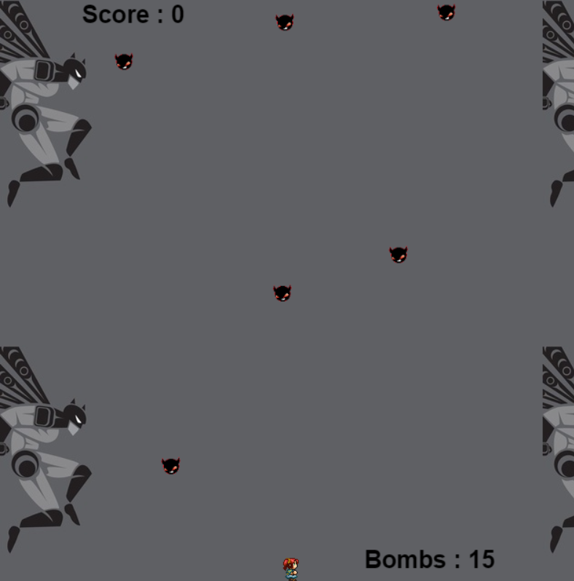
Game Snapshots

Slide 17
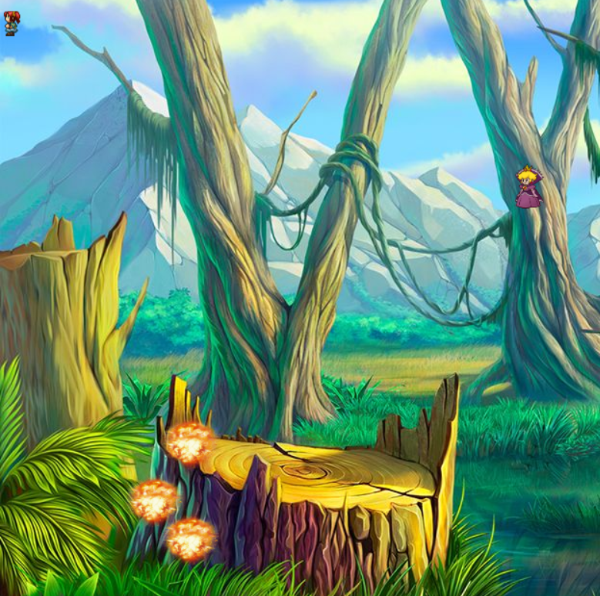
Game Snapshots

Slide 18
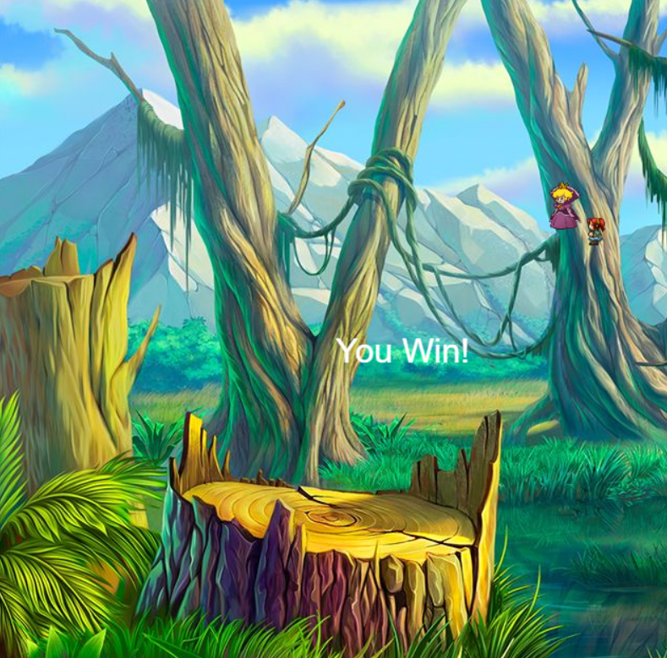
Game Snapshots

Slide 19

Game Live on Heroku
http://boringpeople.herokuapp.com
T.H.E E.N.D

Slide 20
Thank You
T.H.E E.N.D

